Slide 1
ShanghaiTech University
EE 115B: Digital Circuits
Fall 2021
Lecture 17
Hengzhao Yang
December 9, 2021

Slide 2
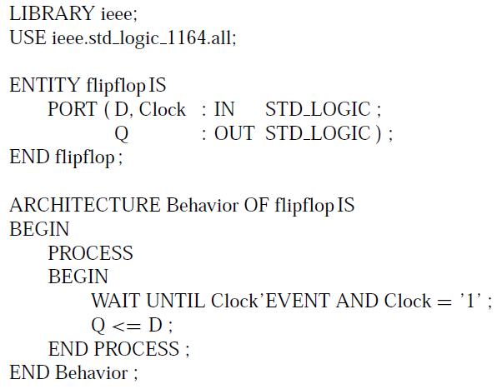
Alternative code for D flip-flop (positive edge)
Alternative code
  Sensitivity list: omitted
  WAIT UNTIL: implying that sensitivity list only includes clock signal
  Some VHDL tools accept a simplified WAIT UNTIL statement (i.e., Clock’EVENT is redundant and removed): WAIT UNTIL Clock=‘1’

Slide 3
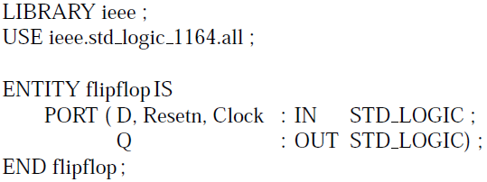
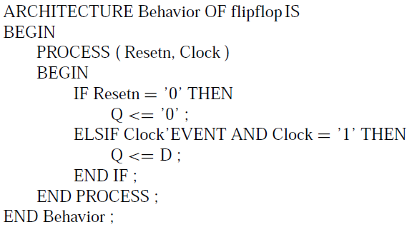
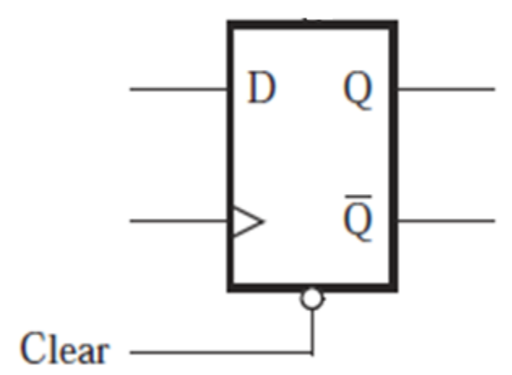
Code for D flip-flop with asynchronous reset (clear)
Asynchronous reset (clear): active low

Slide 4
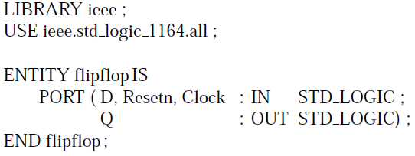
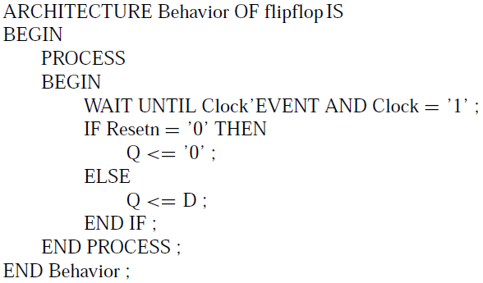
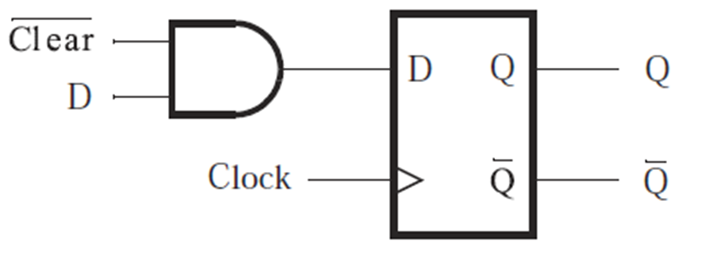
Code for D flip-flop with synchronous reset (clear)
Synchronous reset (clear) acts at clock edge

Slide 5
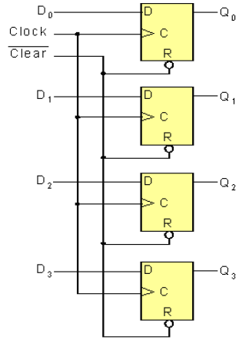
Registers
An N-bit register is a set of N flip-flops used to store N bits of information.
Example: 4-bit register
  One D flip-flop for each bit
  Same Clock and Clear signals for all 4 D flip-flops
  Input: D₀-D₃
  Output: Q₀-Q₃

Slide 6
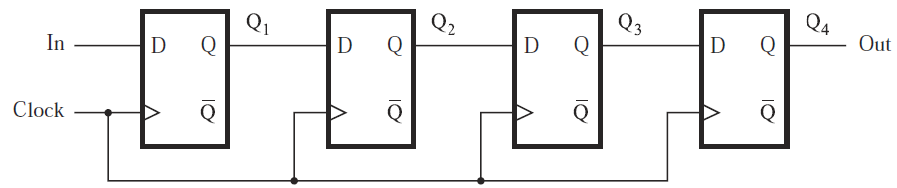
Shift registers
Shift register: a register with the ability to shift its contents
Example: 4-bit shift register

Slide 7
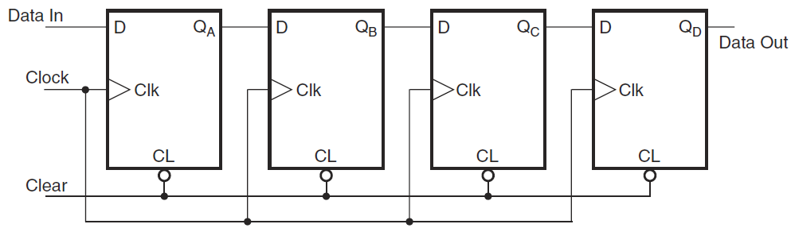
4-bit shift register
Circuit diagram (with asynchronous clear)
Timing diagram (next page)
  Input: 1 (first bit), 0, 0, 1 (last bit)

Slide 8
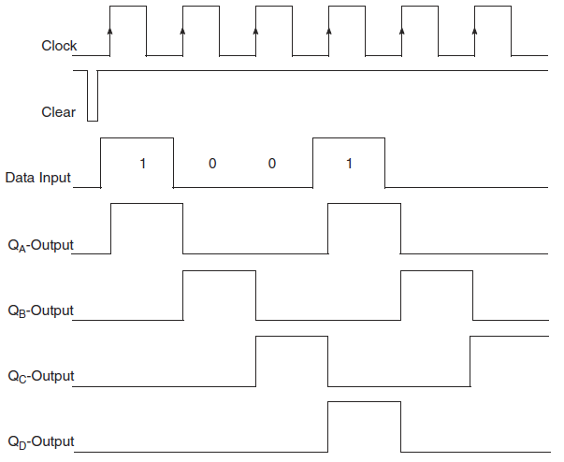

Slide 9
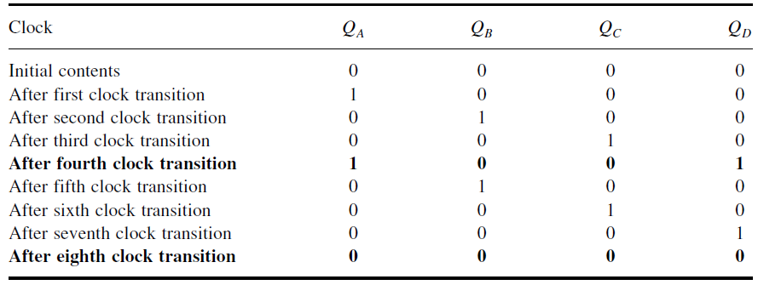
4-bit shift register
Contents of flip-flops
  Input is shifted to the right by one bit during each clock cycle
  An input bit propagates to output after 4 clock cycles
  4 clock cycles to load input, another 4 cycles to read output

Slide 10
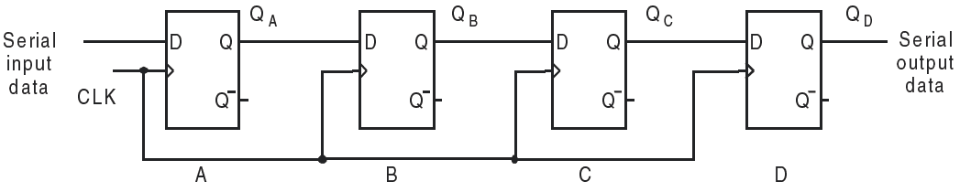
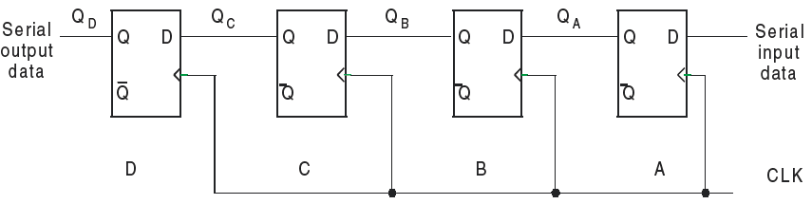
4-bit registers: shift-right and shift-left
Shift-right
Shift-left

Slide 11
Shift register types
4 types depending on the method to load and read data
  Serial-in serial-out (SISO)
  Serial-in parallel-out (SIPO)
  Parallel-in serial-out (PISO)
  Parallel-in parallel-out (PIPO)

Slide 12
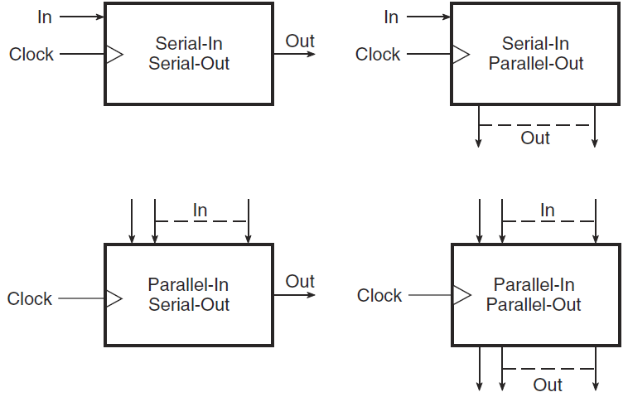
Shift register types

Slide 13

Parallel-access (parallel-loading) shift register
Circuit structure
  Top (D flip-flops): register
  Bottom (2 AND + 1 OR gates): 2-to-1 mux
Mode selection signal:
  Value 0: shift register
    Serial input is selected: serial input to D₃ (D input of leftmost flip-flop), Q₃ to D₂, Q₂ to D₁, Q₁ to D₀
    Shift-right register
  Value 1: parallel loading
    Parallel input is selected

Slide 14
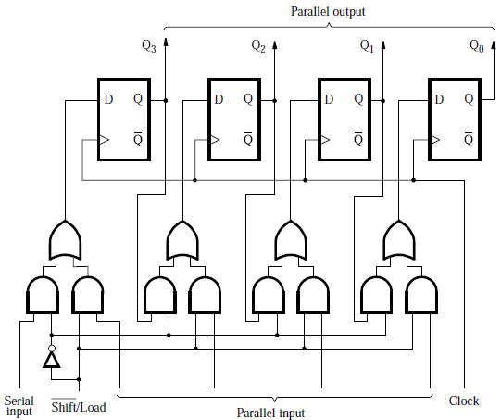

Slide 15
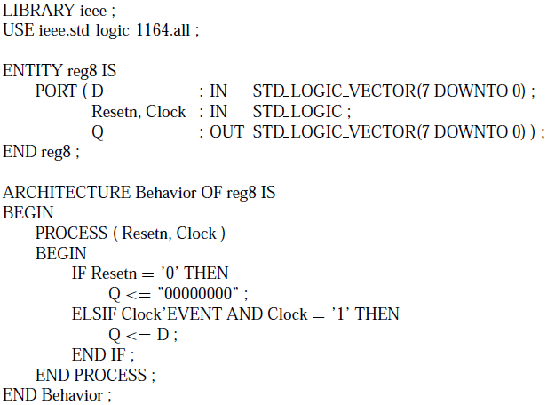
Code for 8-bit register with asynchronous clear

Slide 16
Comparison: Code for D flip-flop with asynchronous reset (clear)
Asynchronous reset (clear): active low

Slide 17
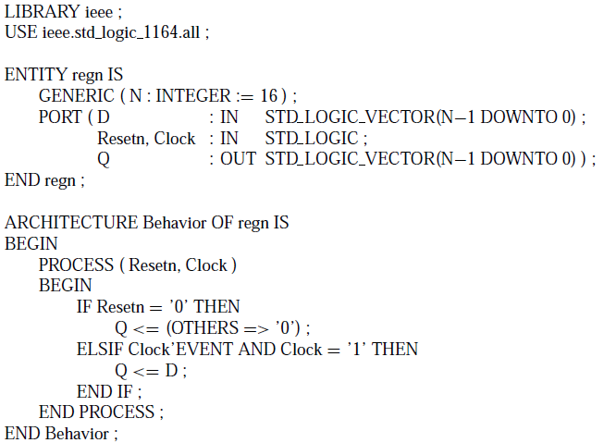
Code for N-bit register with asynchronous clear

Slide 18
Code for N-bit register with asynchronous clear
GENERIC (N: INTEGER := 16)
  Define a parameter (N), its type (INTEGER), and its value (16)
  Assignment operator: “:=”
Q <= (OTHERS => ‘0’)
  Reset all bits of Q to 0 regardless of the bit length of Q
  For N=16, this statement is equivalent to Q<=“0000000000000000”

Slide 19
Structural code for 4-bit parallel-access shift register
Component: a D flip-flop with a 2-to-1 MUX on D input

Slide 20
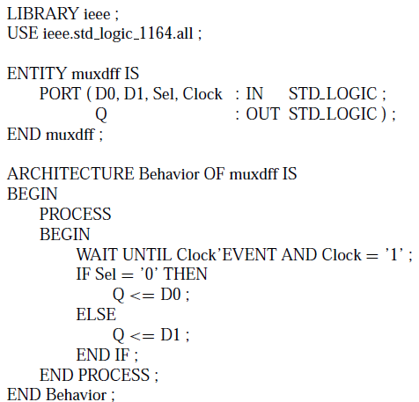
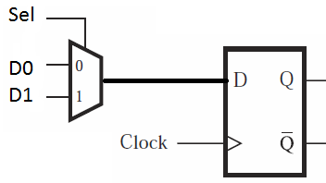
Structural code for 4-bit parallel-access shift register: component
Sel: mode selection
  Sel=0: D=D0 (left-hand AND is active, left signal is selected: serial input or preceding Q)
  Sel=1, D=D1 (right-hand AND is active, right signal is selected: parallel input)

Slide 21
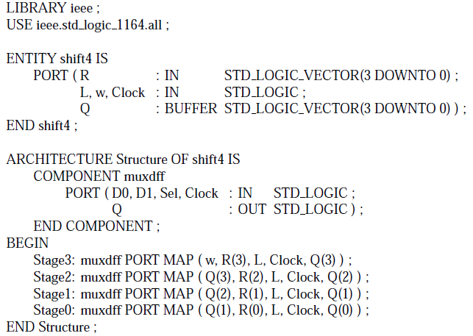
Structural code for 4-bit parallel-access shift register: entire circuit
R: parallel input, L: mode selection, w: serial input

Slide 22

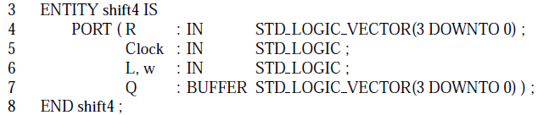
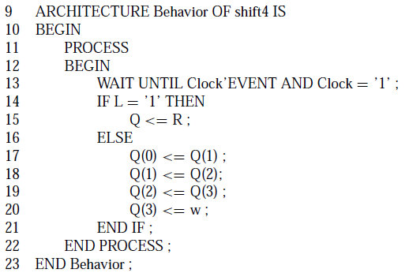
Behavioral code for 4-bit parallel-access shift register

Slide 23

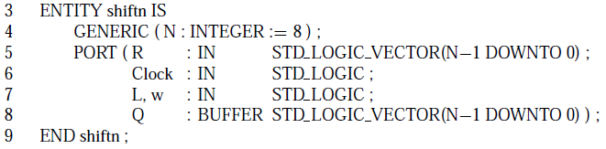
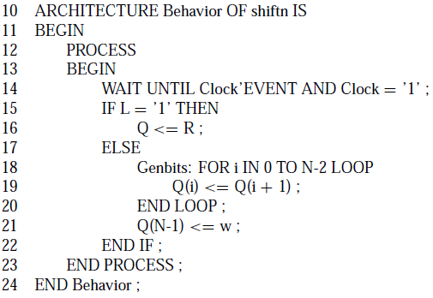
Behavioral code for N-bit parallel-access shift register
FOR LOOP: generate a set of sequential statements

